Slide 1
Cyclostationary Signal Processing
EDA & Potential Applications

Slide 2
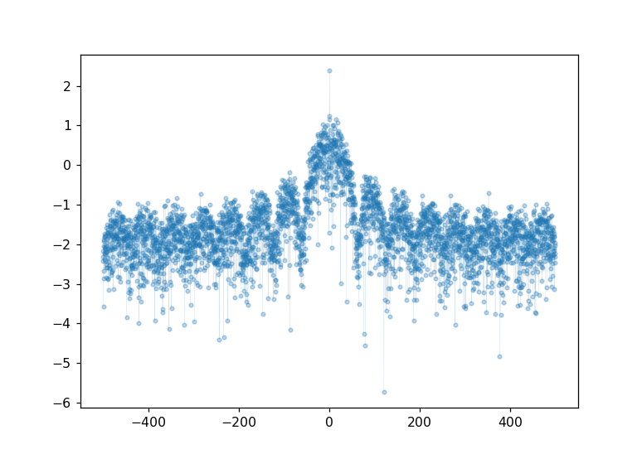
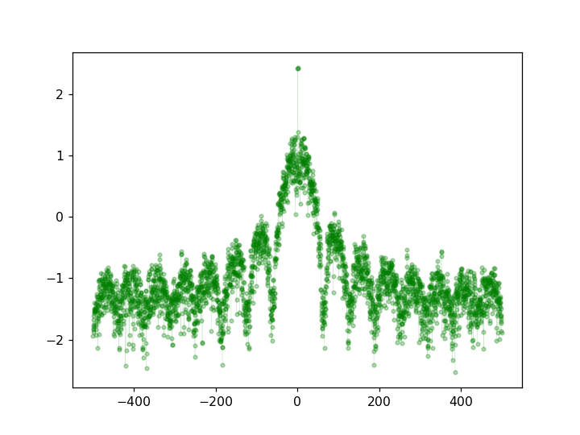
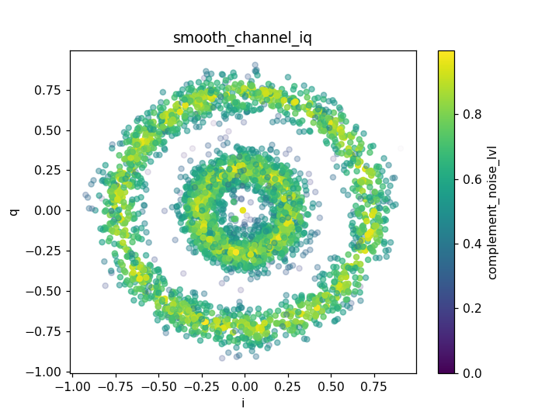
Plots
Channel_iq
nsymbols=2
repeats_per_symbol = 16 # less than 16
samples_per_second = 1e3
message_len = 200
total_samples = repeats_per_symbol*message_len
baseband_carrier_freq = 1 # fc center frequency
noise_sd = 0.10 # noise
BPSK
PSD of Signal (S)
FSM-PSD of Signal (S)
N = 3 , Ts = sym_per_sec, Fs = 1/dt
Frequency smoothing with rectangular box filter.
Frequency Carrier 1.0 | Error |True – approx.|
|1.0 - 0.9375| | 0.0625

Slide 3
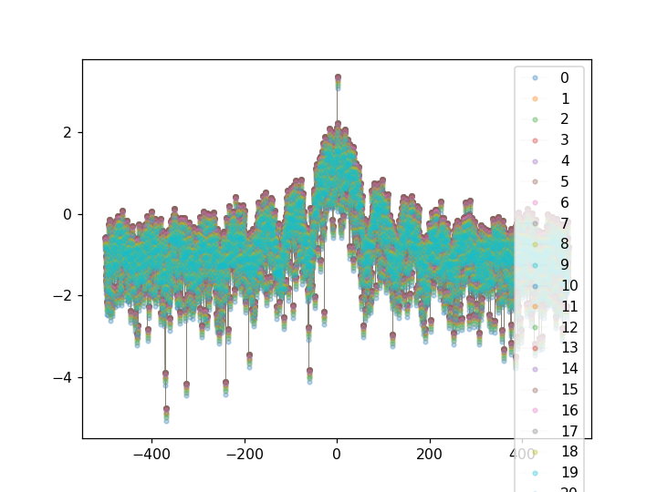
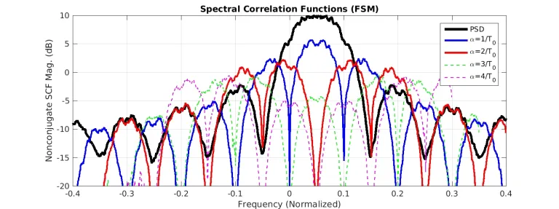
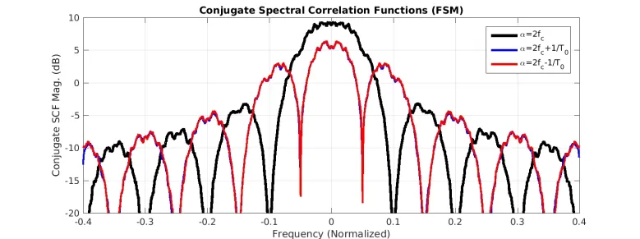
Lessons learned
Discussion areas
cyclic cumulants and cyclic moments can be leveraged for feature design
“Those temporal parameters have proven useful in modulation classification and parameter estimation settings, and will likely be an important part of my ultimate radio-frequency scene analyzer.” – Chad Spooner
Based on the Blog post I expected the SCF to be near 0 for all alphas that are not equal to the theoretical expected alphas. However, my plots seem to only vary slightly around the PSD estimate.
SCF estimation

Slide 4
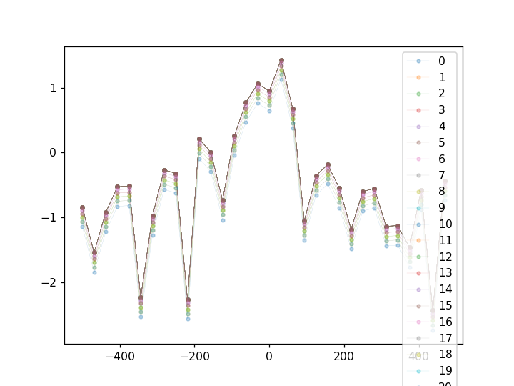
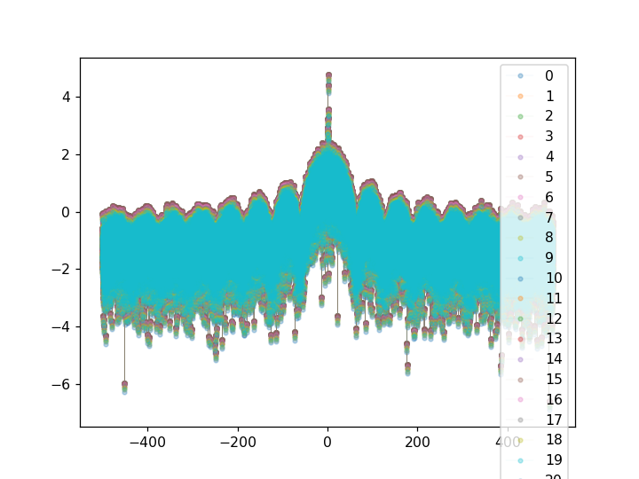
Even for the theoretical alphas I'm not seeing the expected variation between my correlated components. This is most likely due to not down converting the spectrum to baseband, filtering, then measuring the correlation between the signals.
Or this is due to having multiple cycle-periods and am correlating across the same set of cycle’s leading to a PSD that is approximately equal.
The peak frequency does converge to the expected frequency of 1 as the message length increases in size
Frequency Carrier 1.0 | Error |True – approx.|
|1.0 - 0.99609375| | 0.00390625
Message length of 2
Message length of 6400

Slide 5
Next steps
Check to see if I should be correlating a Narrow Band Component of the FFT before smoothing with g(f).
Calculate the Spectral coherence function that can be used for blind modulation detection.
Determine if the features are sensitive to noise using bootstrapping methods, or sensitivity analysis.
Determine the degree of independence using mutual information or Monte Carlo simulations.

